Slide 1
LESSON 07

Slide 2
Overview
of
Previous Lesson(s)

Slide 3
Over View
Context Free Grammar is used to specify the syntax of the language.
A grammar describes the hierarchical structure of most programming language constructs.
It has components
A set of tokens (terminal symbols)
A set of nonterminals
A set of productions
A designated start symbol

Slide 4
Over View..
Syntax-directed translation is done by attaching rules or program fragments to productions in a grammar.
An attribute is any quantity associated with a programming construct .
A translation scheme is a notation for attaching program fragments to the productions of a grammar.
Postfix Notation.

Slide 5
Over View..
Parsing is the problem of taking a string of terminals and figuring out how to derive it from the start symbol of the grammar.
A parser takes at most O (n³) time to parse a string of n terminals.
Top Down Parsing
Bottom Up Parsing
A recursive-descent parsing, in which the lookahead symbol unambiguously determines the flow of control through the procedure body for each non terminal is called predictive parsing.

Slide 6
Over View…
FIRST(α) is the set of terminals that appear as the first symbols of one or more strings generated from α
type → simple
| ^ id
| array [ simple ] of type simple → integer
| char
| num dotdot num
FIRST(simple) = { integer, char, num } FIRST(^ id) = { ^ }
FIRST(type) = { integer, char, num, ^, array }

Slide 7
Over View…
Left Recursion When a production for non terminal A starts with a self reference then a predictive parser stuck in loop forever.
i.e A - > A α | β
α & β are sequences of terminals and non terminals that do not start with A.
A left-recursive production can be eliminated by systematically rewriting the grammar using right recursive productions
A - > β R
R - > α R | ɛ

Slide 8
TODAY’S LESSON

Slide 9
Contents
Translator for Simple Expressions
Abstract and Concrete Syntax
Adapting the Translation Scheme
Lexical Analysis
Removal of White Space and Comments
Reading Ahead
Encode Constants
Recognizing Keywords and Identifiers

Slide 10
Translator for Simple Expressions
Now we construct a syntax directed translator, using Java program, that translates arithmetic expressions (+ , - ) into postfix form.
Following scheme defines the translation to be performed.
expr → expr + term expr → expr - term expr → term term → 0 term → 1 … term → 9
{ print(“+”) } { print(“-”) } { print(“0”) } { print(“1”) } … { print(“9”) }

Slide 11
Translator for Simple Expressions..
Given grammar is left recursive.
Predictive parser cannot handle a left-recursive grammar so we have to remove it.
So after removing the left recursion we got
expr → term rest rest → + term { print(“+”) } rest | - term { print(“-”) } rest | ε term → 0 { print(“0”) } term → 1 { print(“1”) } … term → 9 { print(“9”) }

Slide 12
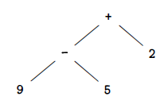
Abstract & Concrete Syntax
A useful starting point for designing a translator is a data structure called an abstract syntax tree.
In an abstract syntax tree for an expression, each interior node represents an operator, the children of the node represent the operands of the operator.
Abstract Syntax tree for 9-5+2

Slide 13
Adapting Translation Scheme
The left-recursion-elimination can also be applied to productions containing semantic actions.
1st step:
Left recursion technique extends to multiple productions.
The technique transforms the productions
A - > Aα | Aβ | γ
into
A - > γR
R - > αR | βR | ɛ
2st step:
Transform productions that have embedded actions.

Slide 14
Adapting Translation Scheme..
Ex Translation scheme:
Assume
A = expr
α = + term {print(‘+’)}
β = - term {print(‘-’)}
γ = term
expr → expr + term expr → expr - term expr → term term → 0 term → 1 … term → 9
{ print(“+”) } { print(“-”) } { print(“0”) } { print(“1”) } … { print(“9”) }

Slide 15
Adapting Translation Scheme..
So the Translation scheme after left recursion elimination:
expr → term rest
rest → + term { print(“+”) } rest
| - term { print(“-”) } rest
| ε
term → 0 { print(“0”) } term → 1 { print(“1”) } … term → 9 { print(“9”) }

Slide 16
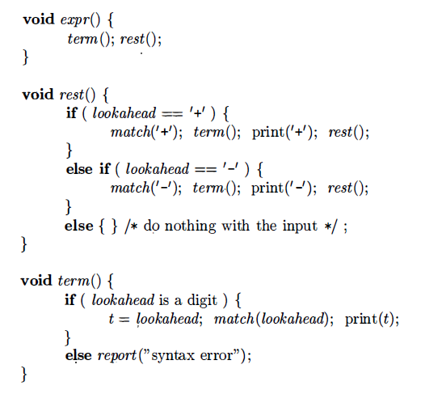
Pseudocodes

Slide 17
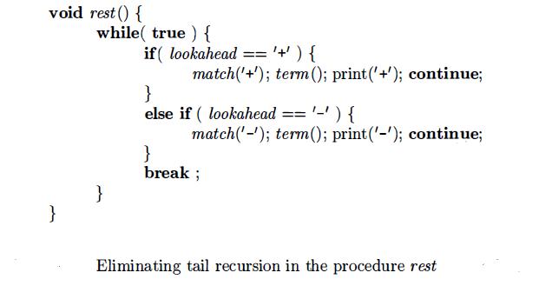
Simplifying the Translator

Slide 18
Structure of our Compiler
Source
Program (Character stream)
Lexical analyzer
Syntax-directed translator
Token stream
Java bytecode
Develop parser and code generator for translator
Syntax definition (BNF grammar)
JVM specification

Slide 19
Lexical Analysis
Typical tasks performed by lexical analyzer:
Remove white space and comments
Encode constants as tokens
Recognize keywords
Recognize identifiers and store identifier names in a global symbol table

Slide 20
Lexical Analysis..
A sequence of input characters that comprises a single token is called a lexeme.
The lexical analyzer allows numbers, identifiers, and "white space“ to appear within expressions.
It can be used to extend the expression translator.
The extended translation to allow numbers and identifiers, also including multiply and division will be:

Slide 21
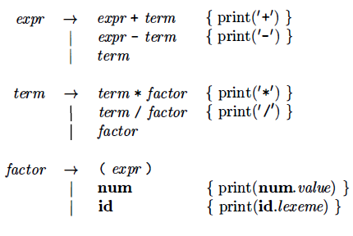
Lexical Analysis...

Slide 22
Removal of White space & Comments
Most languages allow arbitrary amounts of white space to appear between tokens.
Comments are likewise ignored during parsing, so they may also be treated as white space.
If white space is eliminated by the lexical analyzer, the parser will never have to consider it.

Slide 23
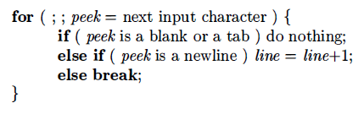
Removal of White space & Comments..
Following code skips white space by reading input characters as long as it sees a blank, a tab, or a newline.

Slide 24
Reading Ahead
A lexical analyzer may need to read ahead some characters before it can decide on the token to be returned to the parser.
Ex. Like Character > >=
An input buffer is maintained from which the lexical analyzer can read and push back characters.

Slide 25
Encode Constants
For a single digit, appears in a grammar for expressions, it is replaced with an arbitrary integer constant .
Integer constants can be allowed either by
Creating a terminal symbol, say num, for such constants.
By incorporating the syntax of integer constants into the grammar.
Ex. Input 16+28+50 It will be transformed into
(num, 31) (+) (num, 28) (+) (num, 59)
Here, the terminal symbol + has no attributes, so its tuple is simply (+)

Slide 26
Keywords & Identifiers
Most languages use fixed character strings such as for, do, and if, as punctuation marks or to identify constructs.
These reserved words are called keywords.
User defined character strings are called identifiers used to name variables, arrays, functions, and the like.
Grammars routinely treat identifiers as terminals to simplify the parser.
Ex. Input: count = count + increment;
Terminal Stream: id = id + id

Slide 27
Keywords & Identifiers..
The token for id has an attribute that holds the lexeme.
By writing tokens as tuples we got:
(id, " count " ) (=) (id, " count " ) (+) (id, " increment " ) ( ; )

Slide 28
Keywords & Identifiers..
The lexical analyzer in this section solves two problems by using a table to hold character strings:
Single Representation: A string table can insulate the rest of the compiler from the representation of strings, since the phases of the compiler can work with references or pointers to the string in the table.
Reserved Words: Reserved words can be implemented by initializing the string table with the reserved strings and their tokens.

Slide 29
Thank You

